Slide 1
U.S.-China Barometer 2022 Long U.S.-China Institute University of California, Irvine
The Barometer provides a multidimensional representation of the U.S.-China relationship based on a compilation of some of the most pertinent data. Political opinions are eschewed, as we would hope that objective metrics would influence political decisions rather than vice-versa.
Our slides include detailed notes and linked datasets which users can access by right clicking graphs and selecting “Edit Data.” We encourage users in the public, private, academic, civic and other sectors to use these data for their own purposes, including education, research, presentations and the like.
We expect and seek your criticism so that we might improve the Barometer in future years. Feel free to send comments to Ben Leffel at bleffel@umich.edu (Twitter: @BenjaminJLeffel) or John L. Graham at jgraham@uci.edu. We extend a special thanks to data engineer Bryan Corder for his assistance in this year’s Barometer.
“To get an accurate picture of the world, you have to count…we should follow the trend lines, not the headlines.” Steven Pinker, 2019
Benjamin Leffel & John L. Graham, September 9, 2022

Slide 2
Comparisons
The Barometer is divided into two sections, “Comparisons” and “Interactions.” This section, Comparisons, presents important attributes of both countries that are largely independent from their interaction, allowing for comparison. As both countries continue along their developmental paths, differences between them may subside, others may widen, and all offer important insight on the trajectories of the world’s two largest economies.

Slide 3
GDP per capita, PPP (current international $)
Source: World Bank
Notes:
The economic impact of COVID-19 is seen in 2020 with the first decline in U.S. GDP per capita since the 2008 financial crisis, while GDP per capita rose in China. This may signal stronger economic recovery on the part of China, but one should also consider that China experienced pandemic conditions months before most of the world, including the U.S., and thus recovered earlier. Both economies bounced back in 2021.

Slide 4
Unemployment rates (%)
Source: World Bank
Notes:
In 2021, the labor market in both countries recovered to an extent from the COVID-19 pandemic impact, with unemployment rates decreasing from the 2020 spike.

Slide 5
Life expectancy at birth (years)
Notes:
Due to the COVID-19 pandemic, life expectancy dropped nearly two years in the U.S. and nearly one year in China. Life expectancy in Hong Kong slightly increased from 2019, as it was less impacted by the pandemic (denoted by a low case-fatality ratio) than the mainland. American leaders should be called to task for delivering declining longevity, falling equal to China on this fundamental statistic.

Slide 6
COVID deaths per million, selected countries, 2019 to mid-2022
Source: theglobaleconomy.com
Notes:
Accusations on both sides have been made about the biases in data collection. Even so, the tremendous difference in the Chinese and American governments’ efficacy in fighting the disease is manifest.

Slide 7
Homicide rate (per 100,000)
Homicide rate (per 100,000)
Source: World Bank
Notes:
China’s homicide rate in 2018 rose for the time on record. They have not reported new data since – this is worrisome. Meanwhile homicide levels have spiked dramatically during the COVID downturn in the U.S. economy during 2020.

Slide 8
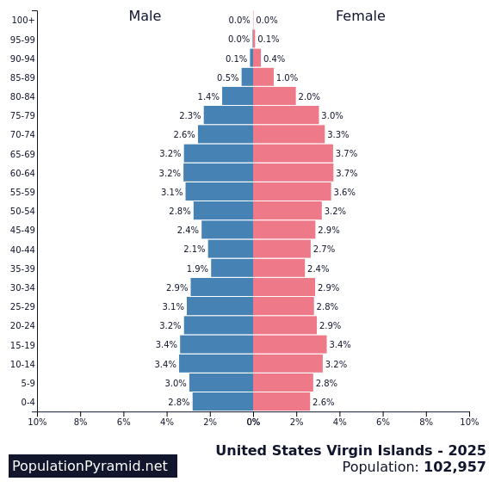
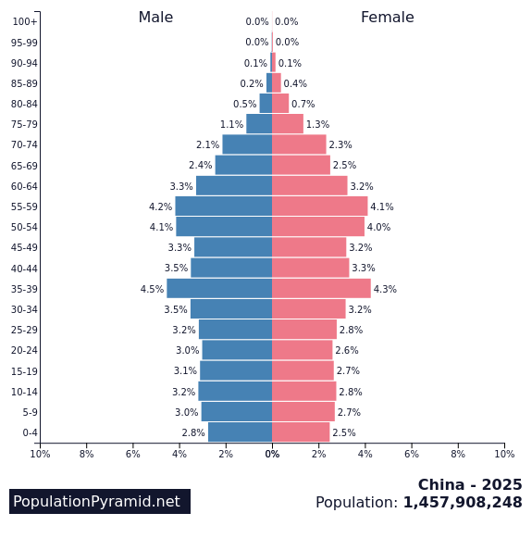
Demographic demons 2025
Notes:
The 2025 population pyramids predict domestic disruptions far into the current decade for both countries. That is, too many old people being supported by too few young people. We have been feeling the effects of this demographic disaster in the United States for the last decade. For both countries much worse is coming during the next two decades. Current social systems designed in the last century will continue to crumble.

Slide 9
Gender inequality index (United Nations, 0.0 = equality)
Source: World Bank
Notes:
A composite measure reflecting inequality in achievement between women and men in three dimensions: reproductive health, empowerment and the labor market. Switzerland scores best (gender inequality is lowest) at 0.039; Papua New Guinea and Chad are worst at greater than 0.70. Things are degrading in both countries durin 2020.

Slide 10
Internet users (%)
Source: World Bank
Notes:
As personal income increases in China, so too does access to such modern amenities as the Internet. Growth in the US has begun to climb again most recently after having stabilized for much of the past decade.

Slide 11
Mobile Phone Subscriptions (% of population)
Source: World Bank
Notes:
Mobile phone penetration is over 100% in both countries. We included the numbers for Hong Kong, the highest penetration rate in the world – the average person owns more than two! The United States has fallen behind in this measure of communications technology.

Slide 12
Source: International Energy Agency
Notes:
Using International Energy Agency (IEA) data, we show on the percentage share of fossil fuel versus renewable energy sources used in electricity generation. This shows that both countries continue to reduce the use of fossil fuels while increasing use of renewable energy in electricity generation. To create the graph, we calculated the fossil fuels metric by combining metrics for electricity production from coal, oil and natural gas, and we calculated the renewable energy metric by combining metrics for electricity generation from biofuels, waste, nuclear, hydro, geothermal, solar photovoltaic, solar thermal and wind power. We converted to percentages the original IEA data for gigawatt hours of each energy source.

Slide 13
Source: https://epi.yale.edu/
Notes:
The Environmental Performance Index (EPI) provides a standardized national-level score for 180 nations over time reflecting collective performance across a range of indicators including air quality, climate change governance, pollution emissions, sanitation, waste management, biodiversity and ecosystem services, for which a higher score indicates superior performance. The U.S. consistently outperforms China during the observed 2006-2022 period, both declining in environmental performance following the 2008 financial crisis and recovering by 2016, and then declining both declining again between 2016 and 2022.

Slide 14
Energy Consumption
Source: International Energy Agency
Notes:
Knowing when to “per capita adjust” is crucial and provides for a more thorough understanding of the phenomenon of interest. We observe electricity use in each countries in both per capita (top-left) and total use (bottom-right) form. The per capita metric allows for greater comparability of the U.S. and China given the two nations have very different population sizes, and shows that while U.S. still exceeds China, it is declining while China’s per capita use is increasing, suggesting China may soon surpass the U.S. in electricity use (even when controlling for population size).
When measured in total use (bottom-right) we see China’s massive increase in electricity consumption in raw form, having surpassed the U.S. after 2010.

Slide 15
CO2 Emissions
Notes:
Directly reflecting the electricity use patterns in both countries are the carbon dioxide (CO2) emissions: The per capita emissions (top-left) in the U.S. are declining though still exceed China, yet China’s increasing emissions appear on track to surpassing the U.S. when controlling for population size. Total CO2 emissions (bottom-right) show that irrespective of population size, China continues to widen the post-2005 gap whereby it surpassed the U.S. in emissions, rapidly increasing while U.S. total emissions slowly decline.

Slide 16
ISO 14001: Environmental management certifications
Source: ISO Survey
Notes:
The International Organization for Standardization (ISO) 14001 certification is the “environmental management” certification earned by businesses and other organizations that demonstrate sustainable operations. China’s 2020 increase from 2019 was the sharpest to date, and the country’s meteoric increase across the observed time period in these certifications comes as a result of the 2001 accession to the World Trade Organization (WTO). While joining the WTO enabled China to export to significantly more foreign markets than years prior, this also brought substantial consumer demand and other pressure for Chinese firms producing exported goods to follow sound environmental standards. Hence the post-accession years were marked by significant increases in ISO 14001 certifications, more than any other country in the world.

Slide 17
Source: World Governance Indicators, World Bank
Notes:
According to WGI: “Voice and Accountability reflects perceptions of the extent to which a country's citizens are able to participate in selecting their government, as well as freedom of expression, freedom of association, and a free media.” We see an ongoing divide between the two nations, the U.S. scoring higher than China given the lack of democracy and restriction of free speech expression in the latter. Both countries, however, are slowly declining.

Slide 18
Fiscal decentralization: China vs. U.S.
$$Fiscal Decentralization=\frac{State \& local tax revenue}{Central tax revenue}$$
Source: IMF Government Finance Statistics
Notes:
The fiscal capacity of Chinese local governments continues in 2020 to remain significantly lower than previous decades, particularly following significant decline in fiscal decentralization since Xi Jinping’s 2013 assumption of office as Chinese President. That is, tax revenue collected has shifted toward central government coffers and away from state and local governments. The U.S. in 2020 continues to show little change.
Fiscal decentralization refers to the extent to which sub-central (state and local) governments collect their own tax revenue, which is important for state/local official’s control of the fiscal capacity used to finance governance activities. We use IMF Government Finance Statistical Yearbooks and estimate fiscal decentralization as the proportion of combined state and local revenue (numerator) and central government tax revenue (denominator), producing a ratio for which a larger value denotes a greater degree of fiscal decentralization, or conditions where central government permits subnational governments to collect their own tax revenue to a greater degree, as opposed to fiscally centralized systems where only the central government collects tax revenue. Our approach is a refinement to Dziobek et al. (2011), who measure fiscal decentralization as the proportion of central government tax revenue and general government tax revenue (all government revenue), which is less immediately representative of the amount of tax revenue that subnational governments generate in each country relative to central government. Our measure also shows greater variation and fewer missing values than taking the ratio of state and local divided by general government revenue.
Reference: Dziobek, Claudia, Carlos Mangas, and Phebby Kufa. 2011. “Measuring Fiscal Decentralization – Exploring the IMF’s Databases.” IMF Working Paper, no. WP/11/126.

Slide 19
Military Spending (billions, current US$)
Source: World Bank
Notes:
In 2020, we see a marginal decline in Chinese military spending while that of the U.S. only continues to climb.

Slide 20
Corruption Perception Index (higher = less corrupt)
Notes:
Here higher numbers reflect less corruption, specifically of the bribery sort. Marginal improvements can be seen in China during the last five years. Again, we have provided the Hong Kong numbers to suggest how things might be improved in the two larger entities. Denmark was ranked #1 with a score of 88, South Sudan was ranked #180 (last) with a score of 11, while the U.S. was ranked #27, Hong Kong #12, and China #66 for the 2021 Index. As can be seen in the chart, the US fell to its worst level ever to 67; on this report card that’s a D. The good news – China continues to move up.

Slide 21
Piracy rates for computer software (% unlicensed use)
Notes:
Piracy rates continue to declining in all three places. We do note that despite the lower piracy rate for the U.S., more money is lost to software piracy in the U.S. than in any other country. The 2016 losses in the U.S. were $8.6 billion, China $6.8 billion, and Hong Kong $277 million. See https://hbr.org/2019/11/is-china-actually-stealing-american-jobs-and-wealth for more details. Additionally, BSA.org, the source of our data opines on the US-China conflicts over IP circa 2018: “…BSA calls on both the U.S. and Chinese governments to engage in dialogue toward achieving mutually beneficial solutions to these challenges” (i.e., IP piracy). The 2022 ranking of the twenty worst pirates (https://www.revenera.com/blog/software-monetization/software-piracy-stat-watch/ ) has China at #1, Russia at #2, and the USA at #3.

Slide 22
Interactions
The second group of slides, “Interactions,” presents relational measures of both countries, showing their various dimensions of direct interaction. As globalization more deeply connects the worlds nations, states, cities and peoples—including that of the U.S. and China—a relational understanding becomes more important.

Slide 23
Trade in goods ($ billion)
Notes:
2020 marked the lowest point in Chinese exports to the U.S. since 2012, having weathered both a trade war waged by the U.S. Trump administration and the shipping and consumption shocks of the COVID-19 pandemic. Positive trends show, however, in increases for both countries in 2021 including a new high for exports to China from the U.S.

Slide 24
Total U.S.-China trade in goods and U.S. trade deficit in goods ($ billion)
Notes:
US/China trade has dipped three times in this century, 2009, 2016, and 2020. All these declines have been associated with declines in the trade deficit of the US. We should note however, two caveats: (1) The U.S. has a trade surplus with China in services as with the rest of the world. (2) Many of the products sent from China to the U.S. are simply assembled in China. For example, the value of iPhone 3G shipped from China to the U.S. contains only 3.6% of components and labor from China. Overall, the continuing U.S. trade deficit with China represents a growing policy problem for the world.

Slide 25
Historical currency exchange rate (yuan per one dollar)
Notes:
In 1994, the yuan was pegged to the U.S. dollar at a value of 8.28, for the purpose of taming domestic instability and to benefit PRC exports. In July 2005, due to pressure from China’s major trading partners, China moved away from the fixed dollar peg, allowing the yuan to gradually appreciate. China sought to internationalize the yuan, which requires a stronger currency. One goal to this end was to get the yuan added to the International Monetary Fund’s Special Drawing Rights basket of reserve currencies—which in 2015 the yuan officially was. However, between the end of 2013 and start of 2014, the dynamics of global currency markets caused the yuan to once again depreciate and continue into 2018. Noteworthy is that this depreciation notwithstanding, it is nevertheless the Chinese government’s goal to strengthen the yuan, not weaken it, which they have succeeded doing up until 2021.

Slide 26
Exchange of direct investment (FDI) ($ billions, source: Rhodium, rhg.com)
Notes:
Investments in one another’s countries is a sign of a growing interdependence and integration of the U.S. and China. The enormous spikes in 2016 and 2017 of Chinese FDI in the US certainly reflect some extent of capital flight as China’s economy became less certain. However, the Rhodium Group (see rhg.com) argues the majority of those funds traveling east across the Pacific represent strategic corporate investments in a broad array of American industrial sectors including manufacturing and real estate. However, the steep declines in Chinese investment beginning in 2017 was worrisome. In 2021, if only temporary, represents a balanced exchange of FDI.

Slide 27
Chinese holdings of U.S. treasuries ($ billion)
Notes:
The growth in Chinese holdings of U.S. treasures has in recent years slowed from its torrid pace. While some argue that this link between the two countries is dangerously volatile, the girth of this Chinese investment in the U.S. renders it much less so.

Slide 28
Travel between countries (thousands of passengers)
Notes:
COVID has killed travel in both directions. This is very bad for bilateral cooperation – hopefully only in the short run.

Slide 29
U.S. patents granted to invention teams that include both American and Chinese citizens
Notes:
Perhaps the most troubling data in the Barometer are year-to-year declines in the collaboration of American and Chinese inventors in 2018 and 2021. During the last decade the growth of collaboration in invention has been quite impressive as illustrated by this graph. While the overall numbers remain small – the U.S. patent offices grants approximately 250,000 patents each year – this does demonstrate that collaboration in R&D is growing fast, despite the recent declines. We have included the numbers of Chinese/California (only) invention teams in orange, demonstrating the close relationship between China and the most inventive state. This has ongoing relevance to our Harvard Business Review argument ‘Is China actually stealing American jobs and wealth?’ See https://hbr.org/2019/11/is-china-actually-stealing-american-jobs-and-wealth for details.

Slide 30
WTO complaints filed
Notes:
Some might say that increases in trade disputes between the two countries is a bad thing. To the contrary, we see the increasing use of the WTO to mediate such disputes a sign of a healthy trade relationship. Third party mediation is the best prophylactic against the damaging trade wars of the past. Unfortunately, in 2019 -2021 trade disputes were argued over in the press, not at the WTO. This is not good for either party.

Slide 31
Educational exchange students
Notes:
We were unable to find data for the numbers of American college students studying in China during 2021. Both COVID and U.S. government policies have worked to decrease the numbers of Chinese college students in the U.S. Again, we can hope this is a short-term problem. But the overall declines in these data is fraught for the future of collaboration and cooperation at all levels. The large decline in Chinese students also means a substantial loss of services exports for the U.S. in terms of lost tuition dollars.

Slide 32
Chinese language training in higher education in U.S. (number of students)
Notes:
While the recent declines in American students’ Chinese language training is troubling. It remains now a smaller drop in the bucket as it is less than 1% of all American college students. Alternatively, all Chinese students take English as part of their tertiary education. Chinese is the 6th most popular foreign language for American students, far behind Spanish, French, German, Japanese and Italian in that order. We can find no more recent data than 2016.

Slide 33
Public opinion
Americans’ ratings of China,
% approving
Chinese ratings of America, % approving
Source: Pew Research Center (2021)
Notes:
Pew measures public opinions in the spring of each year, however during the last three years, Chinese authorities have not allowed Pew to conduct their surveys among the Chinese people. We are at least able to show recent data on U.S. opinion of China, which has reached another record low, likely due to the COVID-19 pandemic and the continuing negative rhetoric of American politicians.

