Slide 1
U.S.-China Barometer 2025 Long U.S.-China Institute University of California, Irvine
The Barometer provides a multidimensional representation of the U.S.-China relationship based on a compilation of some of the most pertinent data. Political opinions are eschewed, as we would hope that objective metrics would influence political decisions rather than vice-versa.
Our slides include detailed notes and linked datasets which users can access by right clicking graphs and selecting “Edit Data.” We encourage users in the public, private, academic, civic and other sectors to use these data for their own purposes, including education, research, presentations and the like.
We expect and seek your criticism so that we might improve the Barometer in future years. Feel free to send comments to Ben Leffel at benjamin.leffel@gmail.com or John L. Graham at jgraham@uci.edu.
“To get an accurate picture of the world, you have to count…we should follow the trend lines, not the headlines.” Steven Pinker, 2019
We do appreciate that much of what has already transpired this year may be a horrible exception to Pinker’s Rule. Ouch!
Benjamin Leffel & John L. Graham, April 25, 2025

Slide 2
Comparisons
The Barometer is divided into two sections, “Comparisons” and “Interactions.” This section, Comparisons, presents important attributes of both countries that are somewhat independent from their interaction, allowing for comparison. As both countries continue along their developmental paths, differences between them may subside, others may widen, and all offer important insight on the trajectories of the world’s two largest economies.

Slide 3
GDP per capita, PPP (current international $)
Source: World Bank
Notes:
The economic impact of COVID-19 is seen in 2020 with the first decline in U.S. GDP per capita since the 2008 financial crisis, while GDP per capita rose in China. This may signal stronger economic recovery on the part of China, but one should also consider that China experienced pandemic conditions months before most of the world, including the U.S., and thus recovered earlier. Both economies bounced back through 2023.

Slide 4
Unemployment rates (%)
Source: World Bank
Notes:
By 2023, the labor market in both countries recovered to an extent from the COVID-19 pandemic impact, with unemployment rates decreasing from the 2020 spike. In 2023 unemployment in the U.S. declined to its lowest level in five decades. Remarkable. Data were not provided to the World Bank by China.

Slide 5
Life expectancy at birth (years)
Notes:
Due to the COVID-19 pandemic, life expectancy dropped nearly two years in the U.S. and nearly one year in China. Life expectancy in Hong Kong slightly increased from 2019, as it was less impacted by the pandemic (denoted by a low case-fatality ratio) than the mainland. American leaders should be called to task for delivering declining longevity, falling equal to and then below China on this fundamental statistic.

Slide 6
COVID deaths per million, selected countries, 2019 to mid-2022
Source: theglobaleconomy.com
Notes:
Accusations on both sides have been made about the biases in data collection. Even so, the tremendous difference in the Chinese and American governments’ efficacy in fighting the disease is manifest.

Slide 7
Homicide rate (per 100,000)
Homicide rate (per 100,000)
Source: World Bank
Notes:
China’s homicide rate in 2018 rose for the first time on record. They have not reported new data since – this is worrisome. Meanwhile homicide levels have spiked dramatically during the COVID downturn in the U.S. economy during 2020-21.

Slide 8
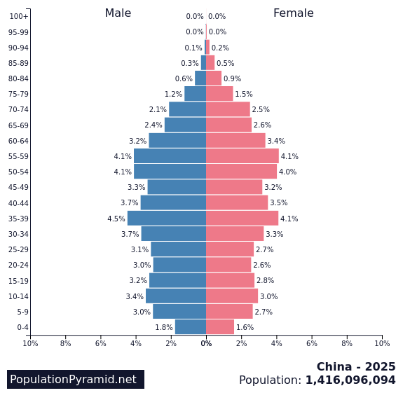
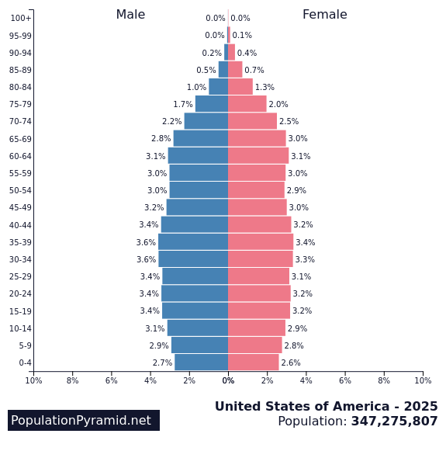
Demographic demons 2025
Source: www.populationpyramid.net
Notes:
The 2030 population pyramids predict domestic disruptions far into the current decade for both countries. That is, too many old people being supported by too few young people. We have been feeling the effects of this demographic disaster in the United States for the last decade. For both countries much worse is coming during the next two decades. Current social systems designed in the last century will continue to crumble.

Slide 9
Gender inequality index (United Nations, 0.0 = equality)
Notes:
A composite measure reflecting inequality in achievement between women and men on three dimensions: reproductive health, empowerment and the labor market. Switzerland scores best (gender inequality is lowest) at 0.039; Papua New Guinea and Chad are worst at greater than 0.70. Things degrade in both countries durin COVID., but now are improving again.

Slide 10
Internet users (%)
Source: World Bank
Notes:
As personal income increases in China, so too does access to such modern amenities as the Internet. Growth in the US has begun to climb again most recently after having stabilized for much of the past decade.

Slide 11
Mobile Phone Subscriptions (% of population)
Source: World Bank
Notes:
Mobile phone penetration is over 100% in both countries. We included the numbers for Hong Kong, the highest penetration rate in the world – the average person owns more than two! The United States has fallen behind in this measure of communications technology. The crash in cellphone subscriptions in Hong Kong is due to a number of factors: SIM card consolidation, eSim technology uptake, real name registration rules, cross-border usage rules, and rising costs.

Slide 12
Notes:
From 1990 to 2022, both the US and China have gradually increased their replacement of fossil fuels (oil, natural gas and coal) with renewables (solar, geothermal, hydropower, wind) in the generation of their electricity, with the U.S. leading China in that race.

Slide 13
Source: https://epi.yale.edu/
Notes:
The Environmental Performance Index (EPI) provides a standardized national-level score for 180 nations over time reflecting collective performance across a range of indicators including air quality, climate change governance, pollution emissions, sanitation, waste management, biodiversity and ecosystem services, for which a higher score indicates superior performance. The U.S. consistently outperforms China during the observed 2006-2022 period, both declining in environmental performance following the 2008 financial crisis and recovering by 2016, and then declining both declining again between 2016 and 2022.

Slide 14
Energy Consumption
Source: International Energy Agency
Notes:
Knowing when to “per capita adjust” is crucial and provides for a more thorough understanding of the phenomenon of interest. We observe electricity use in each countries in both per capita (top-left) and total use (bottom-right) form. The per capita metric allows for greater comparability of the U.S. and China given the two nations have very different population sizes, and shows that while U.S. still exceeds China, it is declining while China’s per capita use is increasing, suggesting China may soon surpass the U.S. in electricity use (even when controlling for population size).
When measured in total use (bottom-right) we see China’s massive increase in electricity consumption in raw form, having surpassed the U.S. after 2010.

Slide 15
CO2 Emissions
Source: International Energy Agency
Notes:
Directly reflecting the electricity use patterns in both countries are the carbon dioxide (CO2) emissions: The per capita emissions (top-left) in the U.S. are declining though still exceed China, yet China’s increasing emissions appear on track to surpassing the U.S. when controlling for population size. Total CO2 emissions (bottom-right) show that irrespective of population size, China continues to widen the post-2005 gap whereby it surpassed the U.S. in emissions, rapidly increasing while U.S. total emissions slowly decline.

Slide 16
China urban GHG change by satellite
GHG reductions (tons)
Data source: Climate TRACE
Notes:
We aggregated to the urban-level the point source GHG emissions remote-sensed from Climate TRACE data, which represents a variety of manufacturing, steel, oil and other facilities globally, between 2015 and 2022. These direct (Scope 1) emissions are represented as change during this period at the city level. If the collective emissions from these sources dropped over time, the urban nodes are displayed as green, for reductions, and the node size is displayed proportional to the amount of reductions. If the collective emissions increased, they are displayed as red. In terms of carbon emissions, China is a land of relative extremes, with both significant increases and significant reductions.

Slide 17
USA urban GHG change by satellite
Data source: Climate TRACE
Notes:
The U.S. map follows the same method as the China map (see notes from slide 16). The urban emissions changes are relatively less extreme than that which is occurring in China, which visibly more reductions between 2015 and 2022 occurring.

Slide 18
US vs. China GHG emissions (by satellite) change - Sector
Notes:
The remote-sense GHG changes in the U.S. versus China shown in previous slides are characterized here in terms of their sectoral breakdown. While both the U.S. and China saw reductions in manufacturing facilities, and increases in transportation and agriculture, the two nations differ in that China’s fossil fuel operations significantly increased in their GHG emissions levels, while those in the U.S. decreased.

Slide 19
US vs. China GHG emissions (by satellite) change – Sub-Sector
Notes:
A more specific sectoral breakdown than slide 18 is shown here, by sub-sector, offering a more granular view of relative emissions changes. The increase in China and decreased in the U.S. for fossil fuel operations is specifically occurring in oil/gas refining operations. Shared decreased in manufacturing are attributable to the cement subsector, and while steel shows shared increases. Shared increases in transportation are attributable to domestic aviation, which outweigh reduction in international aviation sufficiently to show aggregate increases in the transportation sector as shown in the previous slide. Agricultural emissions change is attributable to cropland fires.

Slide 20
Source: World Governance Indicators, World Bank
Notes:
According to WGI: “Voice and Accountability reflects perceptions of the extent to which a country's citizens are able to participate in selecting their government, as well as freedom of expression, freedom of association, and a free media.” We see an ongoing divide between the two nations, the U.S. scoring higher than China given the lack of democracy and restriction of free speech expression in the latter. Both countries, however, are slowly declining.

Slide 21
Source: World Bank
Notes:
The two countries are surprising similar on this measure. Other 2023 examples are Sweden 26.0, Brazil 18.2, Russia 18.5, Mexico 11.1, Japan 21.6.

Slide 22
Military Spending (billions, current US$)
Source: World Bank
Notes:
In 2020, we saw a marginal decline in Chinese military spending while that of the U.S. only continues to climb. And this burgeioning defense budget ignores the more than $300 billion spent by the Veterans Administration every year.

Slide 23
Corruption Perception Index (higher = less corrupt)
Notes:
Here higher numbers reflect less corruption, specifically of the bribery sort. Not much in China has changedduring the last five years. Again, we have provided the Hong Kong numbers to suggest how things might be improved in the two larger entities. Denmark was ranked #1 with a score of 90, South Sudan was ranked #180 (last) with a score of 8, while the U.S. was ranked #28, Hong Kong #17, and China #76 for the 2024 Index. As can be seen in the chart, the US fell to 65,its worst level ever in 2022 and 2024; on this report card that’s a strait D.

Slide 24
Piracy rates for computer software (% unlicensed use)
Notes:
As reported by BSA.org, software piracy rates continue to declining in all three places. We do note that despite the lower piracy rate for the U.S., more money is lost to software piracy in the U.S. than in any other country. The 2016 losses in the U.S. were $8.6 billion, China $6.8 billion, and Hong Kong $277 million. See https://hbr.org/2019/11/is-china-actually-stealing-american-jobs-and-wealth for more details. Additionally, BSA.org, the source of our data opined on the US-China conflicts over IP circa 2018: “…BSA calls on both the U.S. and Chinese governments to engage in dialogue toward achieving mutually beneficial solutions to these challenges” (i.e., IP piracy). Unfortunately, BSA stopped tis ratings after 2017 – this is a great loss in the fight against piracy.The 2022 ranking of the twenty worst pirates (https://www.revenera.com/blog/software-monetization/software-piracy-stat-watch/ ) has China at #1, Russia at #2, and the USA at #3.

Slide 25
Interactions
The second group of slides, “Interactions,” presents relational measures of both countries, showing their various dimensions of direct interaction. As globalization more deeply connects the worlds nations, states, cities and peoples—including those of the U.S. and China—a relational understanding becomes more important.

Slide 26
Exports of goods ($ billion)
Notes:
2023 marked the lowest point in Chinese exports to the U.S. since 2009, having weathered both a trade war waged by the U.S. Trump administration and the shipping and consumption shocks of the COVID-19 pandemic. The recent lack of growth in either direction is alarming, particularly given the most recent Trump tariffs.

Slide 27
Total U.S.-China trade in goods and U.S. trade deficit in goods ($ billions)
Notes:
US/China trade has dipped four times in this century, 2009, 2016, 2020, and 2023. All these declines have been associated with declines in the trade deficit of the US. We should note however, two caveats: (1) The U.S. has a trade surplus with China in services as it does with the rest of the world. (2) Many of the products sent from China to the U.S. are simply assembled in China. For example, the value of iPhone 3G shipped from China to the U.S. contains only 3.6% of components and labor from China. Overall, the continuing U.S. trade deficit with China represents a continutine policy problem for the world.

Slide 28
Historical currency exchange rate (yuan per one dollar)
Notes:
In 1994, the yuan was pegged to the U.S. dollar at a value of 8.28, for the purpose of taming domestic instability and to benefit PRC exports. In July 2005, due to pressure from China’s major trading partners, China moved away from the fixed dollar peg, allowing the yuan to gradually appreciate. China sought to internationalize the yuan, which requires a stronger currency. One goal to this end was to get the yuan added to the International Monetary Fund’s Special Drawing Rights basket of reserve currencies—which in 2015 the yuan officially was. However, between the end of 2013 and start of 2014, the dynamics of global currency markets caused the yuan to once again depreciate and continue into 2018. Noteworthy is that this depreciation notwithstanding, it is nevertheless the Chinese government’s goal to strengthen the yuan, not weaken it, which they have succeeded doing up until 2021.

Slide 29
Exchange of direct investment (FDI flows) ($ billions, source: BEA.gov)
Notes:
Investments in one another’s countries is a sign of a growing interdependence and integration of the U.S. and China. The enormous spikes in 2016 and 2017 of Chinese FDI in the US certainly reflect some extent of capital flight as China’s economy became less certain. However, the Rhodium Group (see rhg.com) argued the majority of those funds traveling east across the Pacific represent strategic corporate investments in a broad array of American industrial sectors including manufacturing and real estate. In any case, the most recent declines and general volatility in FDI flows reflects the fast changes in government policies and fear.

Slide 30
Chinese holdings of U.S. treasuries ($ billion)
Notes:
The growth in Chinese holdings of U.S. treasures has in recent years slowed from its torrid pace. While some argue that this link between the two countries is dangerously volatile, the girth of this Chinese investment in the U.S. renders it much less so.

Slide 31
Travel between countries (thousands of passengers)
Notes:
COVID killed travel in both directions. This is very bad for bilateral cooperation – hopefully only in the short run. Now we see a welcome surge in travel in both directions.

Slide 32
U.S. patents granted to invention teams that include both American and Chinese citizens
32
Notes:
This important measure of technology collaboration continues strong with dips evident in the first Trump administration and associated with COVID19.

Slide 33
WTO complaints filed
Notes:
Some might say that increases in trade disputes between the two countries is a bad thing. To the contrary, we see the increasing use of the WTO to mediate such disputes a sign of a healthy trade relationship. Third party mediation is the best prophylactic against the damaging trade wars of the past. Unfortunately, in 2019 -2021 trade disputes were argued over in the press, not at the WTO. This is not good for either party.

Slide 34
Educational exchange students
Notes:
We were unable to find data for the numbers of American college students studying in China during 2021. Both COVID and U.S. government policies have worked to decrease the numbers of Chinese college students in the U.S. Again, we can hope this is a short-term problem. But the overall declines in these data is fraught for the future of collaboration and cooperation at all levels. The large decline in Chinese students also means a substantial loss of services exports for the U.S. in terms of lost tuition dollars.

Slide 35
Chinese language training in higher education in U.S. (number of students)
Notes:
While the continuing declines in American students’ Chinese language training is troubling. It remains now a smaller drop in the bucket as it is less than 1% of all American college students. Alternatively, all Chinese students take English as part of their tertiary education. Chinese is the 6th most popular foreign language for American students, far behind Spanish, French, German, Japanese and Italian in that order. We can find no more recent estimate than 2023.

Slide 36
Public opinion
Americans’ ratings of China,
% approving
Chinese ratings of America, % approving
Source: Pew Research Center (2025)
Notes:
Pew measures public opinions in the spring of each year, however during the last several years, Chinese authorities have not allowed Pew to conduct their surveys among the Chinese people. We are at least able to show recent data on U.S. opinion of China, which continues to be very low, likely due to the COVID-19 pandemic and the continuing negative rhetoric of American politicians.

