Slide 1
U.S.-China 2021 Barometer Long U.S.-China Institute University of California, Irvine
The Barometer provides a multidimensional representation of the U.S.-China relationship based on a compilation of the most pertinent data. Political opinions are eschewed. Indeed, we would hope that objective metrics would influence political decisions rather than vice-versa.
Our slides include detail notes and linked data sets which users can access by right clicking graphs selecting “Edit Data.” We encourage users in the public, private, academic, civic and other sectors to use these data for their own purposes, including education, research, presentations and the like.
We expect and seek your criticism so that we might improve the Barometer in future years. Feel free to send comments to Ben Leffel at bleffel@uci.edu (Twitter: @BenjaminJLeffel) or John L. Graham at jgraham@uci.edu
“To get an accurate picture of the world, you have to count…we should follow the trend lines, not the headlines.” Steven Pinker, 2019
Benjamin Leffel & John L. Graham, August 11, 2021

Slide 2
Comparisons
The Barometer is divided into two sections, “Comparisons” and “Interactions.” This section, Comparisons, presents important attributes of both countries that are largely independent from their interaction, allowing for comparison. As both countries continue along their developmental paths, differences between them may subside, others may widen, and all offer important insight on the trajectories of the world’s two largest economies.

Slide 3
Source: Wendling, Z.A., J.W. Emerson, A. de Sherbinin, D.C. Etsy, et al. 2020. Environmental Performance Index 2020. New Haven, CT: Yale Center for Environmental Law and Policy. https://doi.org/10.13140/RG.2.2.21182.51529.
Notes:
The Environmental Performance Index (EPI) provides a standardized national-level score for 180 nations over time reflecting collective performance across a range of indicators including air quality, climate change governance, pollution emissions, sanitation, waste management, biodiversity and ecosystem services, for which a higher score indicates superior performance. The U.S. consistently outperforms China during the observed 2006-2020 period, both declining in environmental performance following the 2008 financial crisis and recovering by 2016, and then declining once between 2016 and 2020. The U.S. decline during the latter period is attributed in large part to the weakening of environmental regulations by the Trump administration, and China’s decline in performance during this period is attributed to reliance on coal-powered energy, the COVID-19 pandemic and continued unsustainable fishing practices, among other factors described in the EPI 2020 Report. EPI data are accessible at https://sedac.ciesin.columbia.edu/data/set/epi-environmental-performance-index-2020.

Slide 4
Fiscal decentralization: China vs. U.S.
$$Fiscal Decentralization=\frac{State \& local tax revenue}{Central tax revenue}$$
Source: IMF Government Finance Statistics
Notes:
Our measure shows a significant decline in China’s fiscal decentralization following Xi Jinping’s 2013 assumption of office as Chinese President, where tax revenue collected shifted toward central government coffers and away from state and local governments, the breakdown of which is discussed in the next slides. Meanwhile, the U.S. shows little change. Fiscal decentralization refers to the extent to which sub-central (state and local) governments collect their own tax revenue, which is important for state/local official’s control of the fiscal capacity used to finance governance activities. We use IMF Government Finance Statistical Yearbooks and estimate fiscal decentralization as the proportion of combined state and local revenue (numerator) and central government tax revenue (denominator), producing a ratio for which a larger value denotes a greater degree of fiscal decentralization, or conditions where central government permits subnational governments to collect their own tax revenue to a greater degree, as opposed to fiscally centralized systems where only the central government collects tax revenue. Our approach is a refinement to Dziobek et al. (2011), who measure fiscal decentralization as the proportion of central government tax revenue and general government tax revenue (all government revenue), which is less immediately representative of the amount of tax revenue that subnational governments generate in each country relative to central government. Our measure also shows greater variation and fewer missing values than taking the ratio of state and local divided by general government revenue.
Reference: Dziobek, Claudia, Carlos Mangas, and Phebby Kufa. 2011. “Measuring Fiscal Decentralization – Exploring the IMF’s Databases.” IMF Working Paper, no. WP/11/126.

Slide 5
Central versus local tax revenue: China
Source: IMF Government Finance Statistics
Notes:
A significant fiscal re-centralization occurred in the years immediately following the 2013 start to Xi Jinping’s rule as President of China, shown here with a post-2013 simultaneous decrease in state and local government tax revenues and commensurate increase in central government tax revenues. In 2017, central government tax revenues surpassed that of state and local revenues. The post-2013 centralizing of fiscal authority shown here complements President Xi’s similar centralization of administrative, political power during the same time period.

Slide 6
Central versus local tax revenue: USA
Source: IMF Government Finance Statistics
Notes:
Save for the temporary post-2008 financial crisis drop in central government tax revenue, very little variation in fiscal decentralization is seen in the U.S. breakdown of central versus state/local tax revenues.

Slide 7
ISO 14001: Environmental management certifications
Source: ISO Survey
Notes:
China’s meteoric increase in ISO 14001 certifications comes as a result of the 2001 accession to the World Trade Organization (WTO). While joining the WTO enabled China to export to significantly more foreign markets than years prior, this also brought substantial consumer demand and other pressure for Chinese firms producing exported goods to follow sound environmental standards. Hence the post-accession years were marked by significant increases in ISO 14001 certifications, more than any other country in the world.

Slide 8
ISO 14001: Environmental management certifications
Source: ISO Survey
Notes:
Shown here is a partial breakdown of the specific industry sectors with the most ISO 14001 certifications in China. The top three industries by certification are “Electrical and optical equipment,” “Construction,” and the amalgam represented by “Wholesale & retail trade, repairs of motor vehicles, motorcycles & personal & household goods.” The linked source data, accessible by right-clicking the chart and clicking “Edit Data,” shows all other industry sectors.

Slide 9
ISO 14001: Environmental management certifications
Source: ISO Survey
Notes:
The top three industries by ISO 14001 certification in the U.S. are “Chemicals, chemical products & fibres,” “Basic metal & fabricated metal products,” and “Electrical and optical equipment.” The linked source data, accessible by right-clicking the chart and clicking “Edit Data,” shows all other industry sectors.

Slide 10
COVID-19 Policy Response: U.S. vs. China
Source: Hale, Thomas, et al. (2020). Oxford COVID-19 Government Response Tracker, Blavatnik School of Government.
Notes:
The Oxford COVID-19 Government Response Tracker provides a standardized metric for pandemic policy response across nations, representing indicators of pandemic-related containment and closure policies, economic and support policies, and health system policies such as testing and investments. A score of 100 represents complete shutdown and government prioritization on financial and health support of a population. We show here the relative policy response for the U.S. and China over the course of 2020. China’s early policy response reflects its status as the geographic origin for the pandemic, while the U.S. response began in mid-March following the World Health Organization’s formal declaration of the pandemic.

Slide 11
COVID-19 Case Fatality Ratio: U.S. vs. China
Source: COVID-19 Dashboard by the Center for Systems Science and Engineering (CSSE) at Johns Hopkins University (JHU)
Notes:
The case-fatality ratio, or the proportion of deaths from infection among individuals diagnosed as infected on a given day, is a common measure for the severity of pandemics. The first five months of 2020 saw the highest case-fatality ratio for both countries, which was considerably higher for China than the U.S. However, the actual number of both cases and deaths were significantly higher in the U.S. than in China, providing important context when interpreting this graph. For instance, on the day of China’s highest case-fatality ratio (361), April 17, 2020, there were 357 cases and 1,290 deaths. That same day in the U.S., there were 33,022 cases and 2,091 deaths.

Slide 12
Policy responsiveness to pandemic deaths: USA
Source: Hale, Thomas, et al. (2020). Oxford COVID-19 Government Response Tracker, Blavatnik School of Government.
Notes:
Rises and falls in the number of deaths (blue) appear, unsurprisingly, to influence policy response (black) more immediately than cases or number of recoveries for the observed time period in the U.S. The two largest spikes in deaths, occurring in March and December, were both met with the most stringent policy responses, while the easing of restrictions fallowed the May/June fall in deaths from the initial spike.

Slide 13
Policy responsiveness to pandemic deaths: China
Source: Hale, Thomas, et al. (2020). Oxford COVID-19 Government Response Tracker, Blavatnik School of Government.
Notes:
Changes in China’s pandemic policy response varied most immediately by spikes and falls in deaths, as was the case for the U.S. The January-March spikes in deaths were met with a strong policy response, the early April fall in deaths saw an easing of restrictions, and the mid-April record spike in deaths saw a strong return to lockdowns.

Slide 14
Source: John Hopkins University (June, 2021)
Notes:
The scale of total U.S. COVID-19 deaths compared to that of China (for Jan 2020 – Jan 2021) is shown in this slide, with other nations for comparison.

Slide 15
Life expectancy at birth (years)
Notes:
Due to the COVID-19 pandemic, life expectancy dropped nearly two years in the U.S. and nearly one year in China. Life expectancy in Hong Kong slightly increased from 2019, as it was less impacted by the pandemic (denoted by a low case-fatality ratio) than the mainland.

Slide 16
GDP per capita, PPP (current international $)
Source: World Bank
Notes:
The economic impact of COVID-19 is seen in 2020 with the first decline in U.S. GDP per capita since the 2008 financial crisis, while GDP per capita rose in China. This may signal stronger economic recovery on the part of China, but one should also consider that China experienced pandemic conditions months before most of the world, including the U.S., and thus recovered earlier.

Slide 17
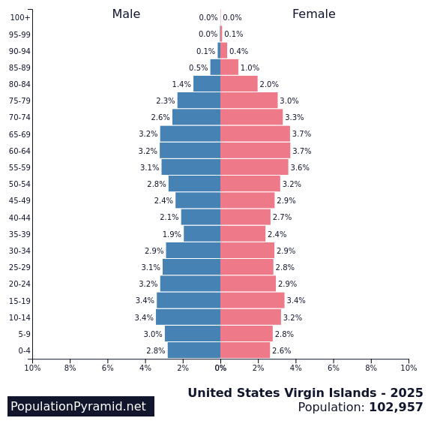
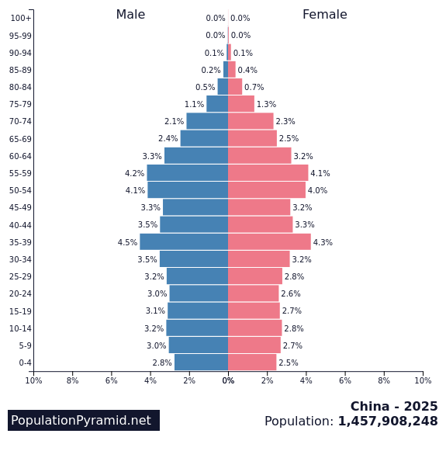
Demographic demons 2025
Notes:
The 2025 population pyramids predict domestic disruptions far into the current decade for both countries.

Slide 18
Unemployment rates (%)
Source: World Bank
Notes:
The impact of the COVID-19 pandemic on labor markets is seen in the 2020 unemployment rate spikes in both countries. That unemployment rose significantly higher in the U.S. than China reflects the 2020 drop in U.S. GDP per capita but rise in China.

Slide 19
Renewable energy transitions
Source: International Energy Agency
Notes:
Using International Energy Agency (IEA) data, we show on the percentage share of fossil fuel versus renewable energy sources used in electricity generation. This shows that both countries are reducing the use of fossil fuels while increasing use of renewable energy in electricity generation. To create the graph, we calculated the fossil fuels metric by combining metrics for electricity production from coal, oil and natural gas, and we calculated the renewable energy metric by combining metrics for electricity generation from biofuels, waste, nuclear, hydro, geothermal, solar photovoltaic, solar thermal and wind power. We converted to percentages the original IEA data for gigawatt hours of each energy source.

Slide 20
Low carbon electricity generation by source: USA
Biofuels, geothermal & waste
Solar
Wind
Nuclear
Hydro
Source: International Energy Agency
Notes:
This displays the breakdown the individual energy sources for renewable (or low carbon) energy for the U.S. As shown in the source data, which accessible by right clicking the graph and selecting “Edit Data,” we combined the original separate metrics for biofuels, geothermal and waste into one category, and did the same for solar PV and solar thermal (shown as “Solar”), to make the graph more visually comprehensible. While nuclear power followed by hydropower served as the main sources of American low carbon electricity from 1990-2005, wind power emerged after 2005 and solar emerged after 2010 with an expanding share of low carbon electricity generation. Nuclear and hydropower, as well as biofuels, geothermal and waste, have gradually tapered as sources of low carbon electricity generation, particularly following the expanded use of wind and solar power.

Slide 21
Low carbon electricity generation by source: China
Biofuels & geothermal
Solar
Wind
Nuclear
Hydro
Source: International Energy Agency
Notes:
This displays the breakdown the individual energy sources for renewable (or low carbon) energy for China. As shown in the source data, accessible by right clicking the graph and selecting “Edit Data,” we combined biofuels and geothermal energy, as well as solar thermal and solar PV, each into one category to make the graph more visually comprehensible. We also exclude tide-based renewable energy, which showed no reported value for 2019. Hydropower was China’s principal source of low carbon electricity generation until 1995, which marked a decade of expanding nuclear energy. Wind power use significantly expanded in 2005 and solar power use expanded in 2010, both continuing growth thereafter while the total share of nuclear and hydro declined. Use of biofuels and geothermal energy as renewable electricity sources gradually increased during this time period. Notable comparisons with the U.S. include that the expanded use of wind (2005) and solar (2010) in China coincided with that of the U.S. , and use of biofuels and geothermal sources show the opposite (increasing) trend in China than in the U.S. (decreasing).

Slide 22
Energy Consumption
Source: International Energy Agency
Notes:
Knowing when to “per capita adjust” is crucial and provides for a more thorough understanding of the phenomenon of interest. We observe electricity use in each countries in both per capita (top-left) and total use (bottom-right) form. The per capita metric allows for greater comparability of the U.S. and China given the two nations have very different population sizes, and shows that while U.S. still exceeds China, it is declining while China’s per capita use is increasing, suggesting China may soon surpass the U.S. in electricity use (even when controlling for population size).
When measured in total use (bottom-right) we see China’s massive increase in electricity consumption in raw form, having surpassed the U.S. after 2010.

Slide 23
CO2 Emissions
Notes:
Directly reflecting the electricity use patterns in both countries are the carbon dioxide (CO2) emissions: The per capita emissions (top-left) in the U.S. are declining though still exceed China, yet China’s increasing emissions appear on track to surpassing the U.S. when controlling for population size. Total CO2 emissions (bottom-right) show that irrespective of population size, China continues to widen the post-2005 gap whereby it surpassed the U.S. in emissions, rapidly increasing while U.S. total emissions slowly decline.

Slide 24
Urban economic & environmental inequality
City-level
USA
China
Neighborhood-level
Source: Urban Environment & Social Inclusion Index, Data-Driven EnviroLab, https://datadrivenlab.org/urban/about/downloads/
Notes:
The Urban Environment & Social Inclusion (UESI) Index, by the Data-Driven EnviroLab, provides downloadable data on a range of large global cities and attributes that explain the relationship between the natural environment and economic growth. These include U.S. and Chinese cities, with metrics on air pollution and green space. While more U.S. than Chinese cities and neighborhoods are represented, valid comparisons may still be made. The two scatterplots shown here depict collective city-level (top-left) and corresponding neighborhood-level (bottom-right) data on air pollution and green space, represented by average micrograms per cubic meter of exposure to fine particulate matter (PM 2.5) and tree cover (proportion of the urban area with tree cover canopy to total area). U.S. and Chinese cities are separated into two distinct groupings, showing that large U.S. cities tend to have lower PM 2.5 levels than Chinese cities, and that Chinese cities with less tree cover tend to have substantially higher PM 2.5 levels, a correlation much less prominent in U.S. cities by comparison. The collective city-level metrics shown in the left-side scatterplot are broken down in more granular form in the right-side (neighborhood) plot, and show that the negative relationship between tree cover and PM 2.5 in Chinese cities is more prominent when observed at the neighborhood-level. When interpreting the above plot, it is important to consider that while both green space and air pollution may directly (and indirectly) influence one another, they are also complex phenomena influenced by a range of other urban factors such as income. The next slide provides more granular data to further explore these associations.
UESI’s methods can be viewed here: http://datadrivenlab.org/wp-content/uploads/2020/02/UESI-Metadata_2020.pdf. Also, the neighborhood-level data shown here are in their original form, which can be accessed in full by right clicking the chart and selecting “Edit Data.”

Slide 25
Neighborhood-level economic & environmental inequality
USA
China
Source: Urban Environment & Social Inclusion Index, Data-Driven EnviroLab, https://datadrivenlab.org/urban/about/downloads/
Notes:
Among other factors such as race, income levels can have a significant influence on air pollution (PM 2.5) and green space, which we explore using the UESI’s neighborhood-level data. We show neighborhood-level income (measured in local currency) and its relationship to tree cover (top-right) and PM 2.5 exposure (bottom-left). Higher-income neighborhoods in large Chinese cities tend to have higher PM 2.5 levels (bottom-left) and less green space (top-right), while those in the U.S. show little of either relationship. Of note, these data are logged to reduce skewness, and users are welcome to explore both the logged and original data by right clicking the graphs and selecting “Edit Data”.

Slide 26
Corporate sustainability: United States
 | UNITED STATES
 | CDP-disclosing firms
Rank | Industry | Number of Facilities
1 | Technology Hardware & Equipment | 105
2 | Chemicals | 73
3 | Food & Beverage Processing | 70
4 | Electric Utilities & Energy Traders | 68
5 | Oil & Gas | 47
6 | Pharmaceuticals, Biotechnology & Life Sciences | 47
7 | Real Estate | 47
8 | Hotels, Restaurants & Leisure, and Tourism | 45
9 | Semiconductors & Semiconductors Equipment | 41
10 | Electrical Equipment and Machinery | 33
 | All others | 150
 | TOTAL | 757
 | High-polluting firms
 | TOTAL | 44,951
Source: Benjamin Leffel
Notes:
We show here the facility-level presence of industry representing both those companies engaging in sustainability activities and those belonging to the highest-polluting industry codes in the U.S. The green nodes denote the presence of companies that disclose climate change governance data to the Carbon Disclosure Project (CDP), a global repository for voluntary disclosure of sustainability performance information. CDP data for the year 2016 is used to display both the geographic spread of the U.S. 757 CDP-disclosing firms, and the top ten industries to which these firms belong as shown in the accompanying table. This represents a partial picture of the facility-level of disclosing firms, as not all disclosing companies include facility coordinates.
The brown nodes represent the facilities of companies belonging to the world’s highest-polluting industry codes. These industry codes were identified as follows: The 2017 CDP Carbon Majors Database lists 100 companies whose operations and facilities globally are responsible for over 70% of global greenhouse gas emissions. We identify the Standard Industrial Classification (SIC) codes for all firms globally, note their location and map them globally, including in the U.S. and China.
We show that U.S. has less CDP-disclosing firms than high-polluting firms, reflective of the broader trend in global corporate sustainability, where the majority of companies do not disclose sustainability performance information. The most common CDP-disclosing industry in the U.S. for observed firms is Technology Hardware & Equipment.

Slide 27
Corporate sustainability: China
 | CHINA
 | CDP-disclosing firms
Rank | Industry | Number of Facilities
1 | Food & Beverage Processing | 57
2 | Technology Hardware & Equipment | 54
3 | Chemicals | 34
4 | Electrical Equipment and Machinery | 20
5 | Semiconductors & Semiconductors Equipment | 20
6 | Food & Staples Retailing | 11
7 | Electric Utilities & Energy Traders | 7
8 | Air Transportation – Airlines | 6
9 | Consumer Durables, Household and Personal | 6
10 | Mining - Other (Precious Metals and Gems) | 6
 | All others | 32
 | TOTAL | 253
 | High-polluting firms
 | TOTAL | 360,512
Source: Benjamin Leffel
Notes:
We show China’s facility-level presence of sustainability-engaged firms and the highest-polluting firms. Green nodes represent CDP-disclosing facilities, again a partial picture given not all such firms disclose coordinates for facilities, and their corresponding industrial composition. Brown nodes represent the same dataset of firms belonging to the highest-polluting industry codes as was included in the previous slide. Like the U.S., China has less CDP-disclosing firms than high-polluting firms, a key difference being that China houses the bulk of high-polluting firms (360,512), reflective both of the post-1970s global shift of manufacturing capital from western nations into China and China’s down domestic growth in manufacturing industries. The most common CDP-disclosing industry for observed firms in China is Food & Beverage Processing.

Slide 28
Source: World Governance Indicators, World Bank
Notes:
According to WGI: “Voice and Accountability reflects perceptions of the extent to which a country's citizens are able to participate in selecting their government, as well as freedom of expression, freedom of association, and a free media.” We see an ongoing divide between the two nations, the U.S. scoring higher than China given the lack of democracy and restriction of free speech expression in the latter. Both countries, however, are slowly declining.

Slide 29
Political Rights
Source: Freedom House
Notes:
The 1-8 scoring scale of Freedom House’s Political Rights index places “1” as the highest (most political rights) and “8” as the lowest (least political rights). “Political Rights” are defined as (1) Electoral process—executive elections, legislative elections, and electoral framework; (2) Political pluralism and participation—party systems, political opposition and competition, political choices dominated by powerful groups, and minority voting rights; and (3) Functioning of government—corruption, transparency, and ability of elected officials to govern in practice. The data series begins in 1972, when Chinese politics were entombed in Mao Zedong’s centralized autocratic rule, cult of personality and all. The period of 1977-1987 in China covers Deng Xiaoping’s reform and opening up in China, when slight political pluralization was tolerated in the service of modernizing the Chinese system. However, the pro-democracy protests which swelled in 1988 and peaked with the 1989 Tiananmen Massacre brought China’s political rights score back to 7, where it remains today. The U.S. maintained a high political rights score of 1 since 1972, until the 2016 election of President Donald Trump which was heavily influenced by Russian interference in the American electoral process, at which point the U.S. political rights score dropped for the first time. The duration of the Trump administration further saw no improvement in the score.

Slide 30
Homicide rate (per 100,000)
Homicide rate (per 100,000)
Source: World Bank
Notes:
China’s homicide rate in 2018 rose for the time on record, while it continues to fluctuate in the U.S., albeit on a much larger scale than China.

Slide 31
Military Spending (billions, current US$)
Source: World Bank
Notes:
In 2020, we see a marginal decline in Chinese military spending while that of the U.S. only continues to climb.

Slide 32
Gender inequality index (United Nations, 0.0 = equality)
Source: World Bank
Notes:
A composite measure reflecting inequality in achievement between women and men in three dimensions: reproductive health, empowerment and the labor market. Switzerland scores best (gender inequality is lowest) at 0.039; Papua New Guinea and Chad are worst at greater than 0.70. Things are improving in both the U.S. and China with inequality declines, if only marginally. And the uptick in 2018 in China a concern.

Slide 33
Internet users (%)
Source: World Bank
Notes:
As personal income increases in China, so too does access to such modern amenities as the Internet. Growth in the US has begun to climb again most recently after having stabilized for much of the past decade.

Slide 34
Mobile Phones (% of population)
Source: World Bank
Notes:
Mobile phone penetration is over 100% in both countries. We included the numbers for Hong Kong, the highest penetration rate in the world – the average person owns more than two!

Slide 35
Corruption Perception Index (higher = less corrupt)
Notes:
Here higher numbers reflect less corruption, specifically of the bribery sort. Marginal improvements can be seen in China during the last five years. Again, we have provided the Hong Kong numbers to suggest how things might be improved in the two larger entities. New Zealand was ranked #1 with a score of 87, Somalia was ranked #180 (last) with a score of 9, while the U.S. was ranked #23, Hong Kong #16, and China #80 for the 2019 Index. As can be seen in the chart, the US fell to its worst level ever to 67; on this report card that’s a D.

Slide 36
Piracy rates for computer software (% unlicensed use)
Notes:
Piracy rates continue to declining in all three places. We do note that despite the lower piracy rate for the U.S., more money is lost to software piracy in the U.S. than in any other country. The 2016 losses in the U.S. were $8.6 billion, China $6.8 billion, and Hong Kong $277 million. See https://hbr.org/2019/11/is-china-actually-stealing-american-jobs-and-wealth for more details. Additionally, BSA.org, the source of our data opines on the US-China conflicts over IP circa 2018: “…BSA calls on both the U.S. and Chinese governments to engage in dialogue toward achieving mutually beneficial solutions to these challenges” (i.e., IP piracy). The 2021 ranking of the twenty worst pirates (https://www.revenera.com/blog/software-monetization/software-piracy-stat-watch/ ) has China at #1, USA at #8, and Hong Kong at #14.

Slide 37
Interactions
The second group of slides, “Interactions,” presents relational measures of both countries, showing their various dimensions of direct interaction. As globalization more deeply connects the worlds nations, states, cities and peoples—including that of the U.S. and China—a relational understanding becomes more important.

Slide 38
Corporate ties by industry
Notes:
Shown here are the top three industries linking the U.S., China and Taiwan in the corporate world. We distilled all U.S.-China-Taiwan corporate ties, defined as 3,557 firms and the 2,503 headquarter-branch/parent-subsidiary relationships between them, into the individual industries. We then identified semiconductors, electronic components and wholesale electronic equipment as the three industries comprising the most corporate ties among the three nations, and in that order, the relative number of industry ties denoted by line width. While semiconductors and electronic components connect all three nations, wholesale electronic equipment connects Taiwan to both China and the US, but not the US to China. We use Lexis Nexis Directory of Corporate Affiliation (2016) data, first transforming listings into firm-to-firm (network) relationships by location, then collating by industry. Of note, we originally observed that industries with the most frequent ties were Offices of Holding companies (SIC 6719) and Security Brokers, Dealers and Flotation Companies (SIC 6211), however, we removed them since these are industries in the business of owning shares of other companies, thus offering no novel industrial linkage.

Slide 39
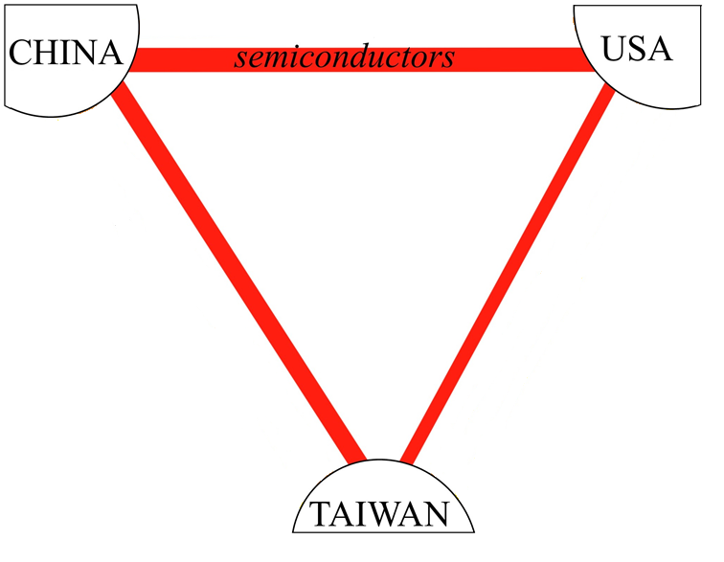
Semiconductors
Diodes Incorporated (4 ties)
Taiwan Semiconductor Manufacturing Co. (5 ties)
Audix Corporation (7 ties)
Notes:
This slide isolates the US-China-Taiwan corporate ties only within the Semiconductor industry, or the single industry most connecting the three nations. To provide examples of individual firms, three semiconductor firms with the most simultaneous ties between each country is displayed. Diodes Inc. has the most US-China ties, Audix Corporation has the most China-Taiwan ties, and Taiwan Semiconductor Manufacturing Co. has the most US-Taiwan ties.

Slide 40
Trade in goods ($ billion)
Notes:
2020 marked the lowest point in Chinese exports to the U.S. since 2012, having weathered both a trade war waged by the U.S. Trump administration and the shipping and consumption shocks of the COVID-19 pandemic. A positive trend shows, however, in increased 2020 U.S. exports to China from the previous year.

Slide 41
Total U.S.-China trade in goods and U.S. trade deficit in goods ($ billion)
Notes:
US/China trade has dipped three times in this century, 2009, 2016, and 2019-20. All these declines have been associated with declines in the trade fdeficit of the US. We should note however, two caveats: (1) The U.S. has a trade surplus with China in services as with the rest of the world. (2) Many of the products sent from China to the U.S. are simply assembled in China. For example, the value of iPhone 3G shipped from China to the U.S. contains only 3.6% of components and labor from China. Overall, a record U.S. trade deficit with China represents a growing policy problem for the world for 2021.

Slide 42
Covid-19’s effect on trade U.S. exports of goods (millions USD$)
Notes:
As we know from the previous two slides, 2019 was a bad year for trade between the U.S. and China. Exports to one another fell in both countries. The good news for the U.S. in this chart is that China remained a resilient export market for American goods. This is so despite the crash of U.S. exports to the rest of the world. Meanwhile, Chinese exports to the U.S. fell 9.4% during the 2nd (COVID-19) quarter of 2020 compared to the 2019 numbers. We can now see marginal improvements in both numbers as of April 2021.

Slide 43
Historical currency exchange rate (yuan per one dollar)
Notes:
In 1994, the yuan was pegged to the U.S. dollar at a value of 8.28, for the purpose of taming domestic instability and to benefit PRC exports. In July 2005, due to pressure from China’s major trading partners, China moved away from the fixed dollar peg, allowing the yuan to gradually appreciate. China sought to internationalize the yuan, which requires a stronger currency. One goal to this end was to get the yuan added to the International Monetary Fund’s Special Drawing Rights basket of reserve currencies—which in 2015 the yuan officially was. However, between the end of 2013 and start of 2014, the dynamics of global currency markets caused the yuan to once again depreciate and continue into 2018. Noteworthy is that this depreciation notwithstanding, it is nevertheless the Chinese government’s goal to strengthen the yuan, not weaken it, which they have succeeded doing up until 2021.

Slide 44
Exchange of direct investment (FDI) ($ billions, source: Rhodium, rhg.com)
Notes:
Investments in one another’s countries is a sign of a growing interdependence and integration of the U.S. and China. The enormous spikes in 2016 and 2017 of Chinese FDI in the US certainly reflect some extent of capital flight as China’s economy became less certain. However, the Rhodium Group (see rhg.com) argues the majority of those funds traveling east across the Pacific represent strategic corporate investments in a broad array of American industrial sectors including manufacturing and real estate. However, the steep declines in Chinese investment beginning in 2017 is worrisome.

Slide 45
Chinese holdings of U.S. treasuries ($ billion)
Notes:
The growth in Chinese holdings of U.S. treasures has in recent years slowed from its torrid pace. While some argue that this link between the two countries is dangerously volatile, the girth of this Chinese investment in the U.S. renders it much less so.

Slide 46
Travel between countries (thousands of passengers)
Notes:
Growth in travel to China by Americans has returned in the last three years. Meanwhile, Chinese travel to the U.S. which burgeoned since 2009 has now shrunk two years running. We expect travel in both directions to crash in 2020 because of COVID-19.

Slide 47
U.S. patents granted to invention teams that include both American and Chinese citizens
Notes:
Perhaps the most troubling datum in the Barometer was the first ever year-to-year decline in the collaboration of American and Chinese inventors in 2018. During the last decade the growth of collaboration in invention has been quite impressive as illustrated by this graph. While the overall numbers remain small – the U.S. patent offices grants approximately 250,000 patents each year – this does demonstrate that collaboration in R&D is growing fast, despite the decline in 2018. We have included the numbers of Chinese/California (only) invention teams in orange, demonstrating the close relationship between China and the most inventive state. The good news is that growth in hightech collaboration has begun to grow again. See https://hbr.org/2019/11/is-china-actually-stealing-american-jobs-and-wealth for details.

Slide 48
WTO complaints filed
Notes:
Some might say that increases in trade disputes between the two countries is a bad thing. To the contrary, we see the increasing use of the WTO to mediate such disputes a sign of a healthy trade relationship. Third party mediation is the best prophylactic against the damaging trade wars of the past. Unfortunately, in 2019 and 2020 trade disputes were argued over in the press, not at the WTO. This is not good for either party.

Slide 49
Educational exchange students
Notes:
Educational exchange between the two countries remains dominated by Chinese students coming to the U.S. Meanwhile, American students travel to China has stabilized at a discouraging low level. We can now see COVID-19 caused declines in Chinese students in the U.S. and vice-versa. U.S. data for 2019 is missing.

Slide 50
Chinese language training in higher education in U.S. (number of students)
Notes:
While the recent declines in American students’ Chinese language training is troubling. It remains now a smaller drop in the bucket as it is less than 1% of all American college students. Alternatively, all Chinese students take English as part of their tertiary education. Chinese is the 6th most popular foreign language for American students, far behind Spanish, French, German, Japanese and Italian in that order.

Slide 51
Public opinion
Americans’ ratings of China,
% approving
Chinese ratings of America, % approving
Source: Pew Research Center (2021)
Notes:
Pew measures public opinions in the spring of each year, however during the last three years, Chinese authorities have not allowed Pew to conduct their surveys among the Chinese people. We are at least able to show recent data on U.S. opinion of China, which has reached a record low, likely due to the COVID-19 pandemic.

